Slide 1

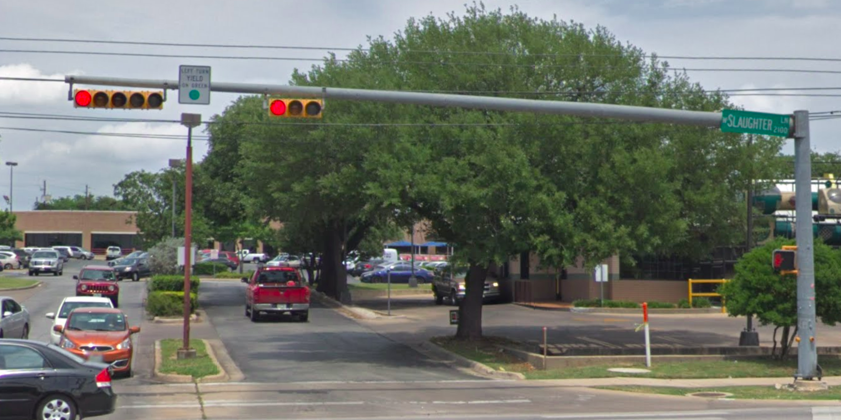
Austin Transportation Department Signs Work Orders
Created By: Susanne Gov Created Date: 2020-08-10 Location Name: SLAUGHTER LN / RIDDLE RD Intersection ID: 5148311 Cardinal Direction: N Work Order ID: SG-20747
Sign Type | Install/Remove
Left Turn Yield On Green | Install
Street Name Sign | Install
Left Turn Signal Yield On Green | Remove

Slide 2
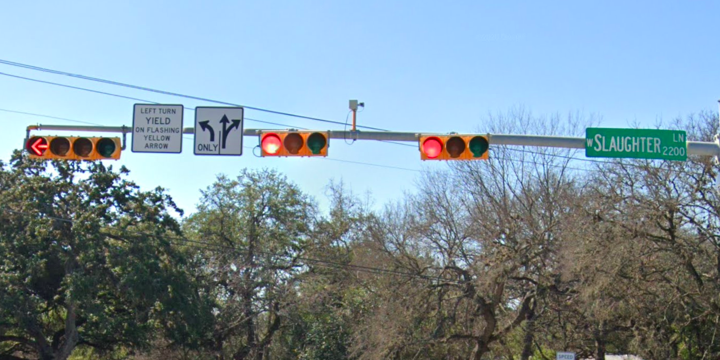
Austin Transportation Department Signs Work Orders
Created By: Susanne Gov Created Date: 2020-08-10 Location Name: SLAUGHTER LN / RIDDLE RD Intersection ID: 5148311 Cardinal Direction: S Work Order ID: SG-20747
Sign Type | Install/Remove
Left Turn Arrow Only | Install
Left Turn Yield Flashing Yellow | Remove
Street Name Sign | Install
Straight Right Arrow | Install

Slide 3
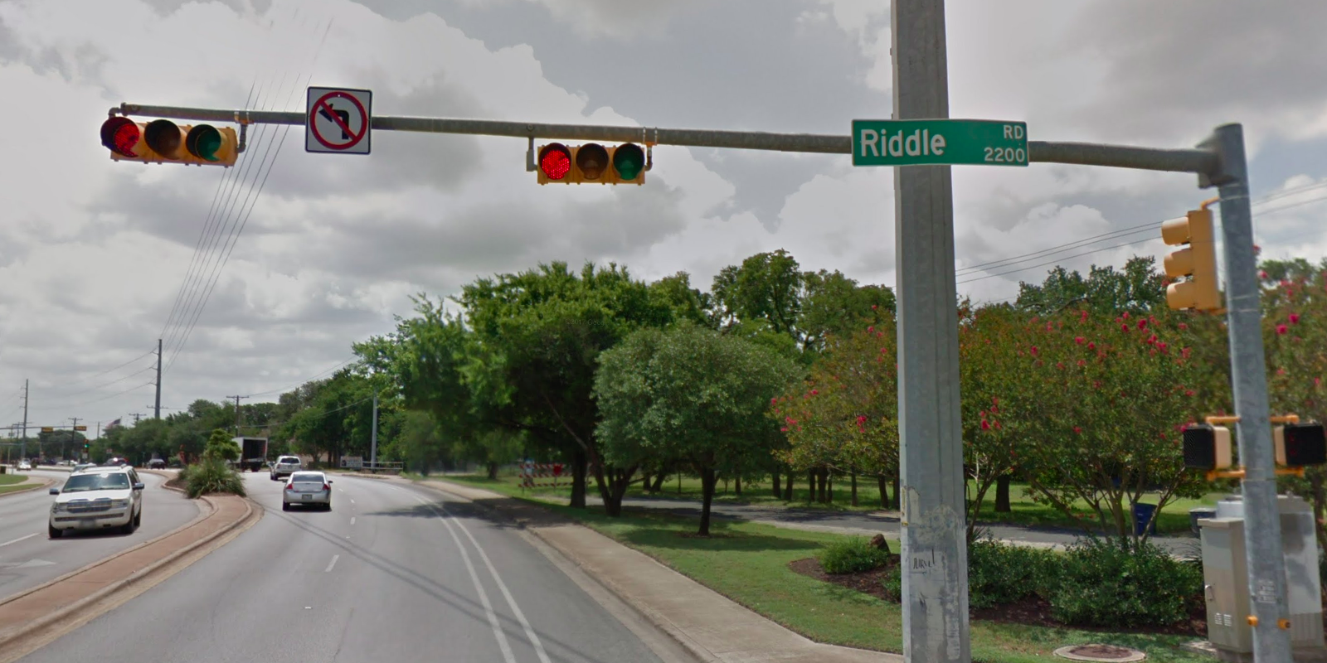
Austin Transportation Department Signs Work Orders
Created By: Susanne Gov Created Date: 2020-08-10 Location Name: SLAUGHTER LN / RIDDLE RD Intersection ID: 5148311 Cardinal Direction: E Work Order ID: SG-20747
Sign Type | Install/Remove
Street Name Sign | Install
No Left Turn Arrow | Install

Slide 4
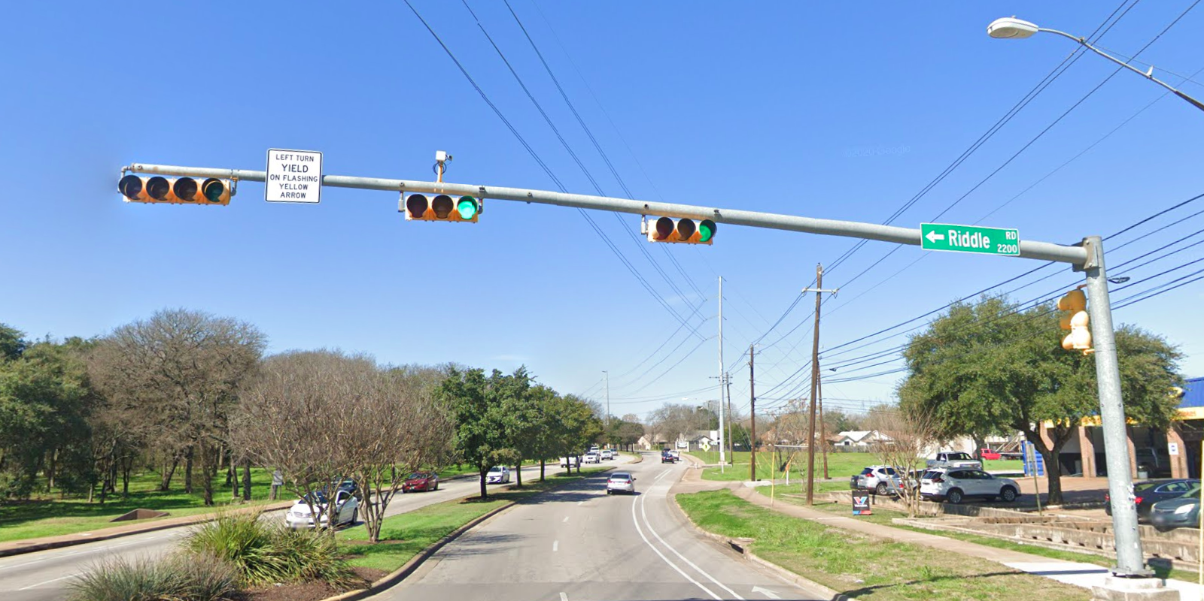
Austin Transportation Department Signs Work Orders
Created By: Susanne Gov Created Date: 2020-08-10 Location Name: SLAUGHTER LN / RIDDLE RD Intersection ID: 5148311 Cardinal Direction: W Work Order ID: SG-20747
Sign Type | Install/Remove
Left Turn Yield Flashing Yellow | Remove
Street Name Sign | Install

